Slide 1


NAVIGATING GERMAN UNIVERSITY CULTURE : INSIGHTS FOR INTERNATIONAL STUDENTS
INTERNATIONAL OFFICE | JUSTINTERNATIONAL SERIES

Slide 2
CONTENTS
German Academic System
Creating your Time-Table
Academic Expectations
Communication with Professors
Practical Insights for a better start
A – Z Guide

Slide 3
TYPES OF UNIVERSITIES IN GERMANY
Over 400 universities in Germany, out of which 75 percent are public institutions. In these universities, students are expected to pay semester contributions which covers the cost of semester ticket as well as other administrative costs.
Full University / Technical University
University of Applied Sciences (Fachhochschule)
Art Academies

Slide 4
TYPES OF UNIVERSITIES IN GERMANY
Justus Liebig Universität Gießen is a state-run, full university that offers courses in:
Law
Economics
Natural and Life Sciences (including Medical Sciences)
Humanities
Cultural and Social Sciences
Teacher Training
All regular degree programs are tuition-free but you have to pay a small semester contribution

Slide 5

FACULTIES AT JLU

Slide 6
DEGREES FOR FULL-TIME STUDENTS
Bachelor Programs
  6 semesters (3 years)
  many different programs from almost all fields of study
  e.g.Biology, Business Studies, Psychology, Anglophone Studies, …
Master Programs
  2-4 semesters (1-2 years)
  can be studied after completing a Bachelor program
  many different programs from almost all fields of study; e.g. Democracy and Governance, Choreography and Performance, German Studies, …

Slide 7
DEGREES FOR FULL-TIME STUDENTS
State Examination programs
  between 6 and 13 semesters (3-7 years),depending on the program
  Law, Medicine, Teacher Training

Slide 8
CURRICULUM
In Bachelor, Master and some State Examination programs, classes are offered as part of modules
  Modules bundle together classes sharing a thematic and/or methodological approach.
  Modules usually consist of two or three different classes.
  Module contents, kinds of examinations and learning goals are codified.
International students studying an entire program at Justus Liebig University must pay attention to module structures in order to successfully complete their studies.

Slide 9
CURRICULUM
For each class,there is a pre-defined workload. The workload for a class is the sum of the hours of work spent for the respective class. It includes class participation and preparations for classes and examinations.
30hours of work= 1 CP / ECTS point
Credit points thus measure the quantitative workload students must spend for their classes.
Additionally, for a successfully completed class, you will beawarded grades, which measure the qualitative success of a class.

Slide 10
INFORMATION ON DATES AND TIMES
Winter Semester : 01.10 - 31.03
Summer Semester : 01.04 – 30.09
Re-registration every semester
10 am c.t. → 10:15 am
10 am s.t. → 10:00 am
Lectures and seminars at Justus Liebig University usually start c.t., which is why this is often not explicitly stated.
A detailed video on this topic can also be found on the OWIS-Website.

Slide 11
LECTURES & SEMINARS
In a lecture (Vorlesung), the lecturer delivers information the students need to know. Several hundred students often sit in the lecture hall at the same time or attend the lecture as an online event. Students are not expected to participate orally.
A seminar (Seminar), on the other hand, is discussion-oriented and takes place in a smaller setting with a maximum of about 50 students. In this type of course, students are expected to actively participate in the discussion.

Slide 12
TUTORIALS & EXAMS
To deepen understanding and apply the material, tutorials (Übungen) are offered.
After you have found the desired courses in the electronic course catalog (eVV), register for your exams (MAP, etc.) via Stud.IP and/or FlexNow. You will be informed by your course instructor in good time should there be any changes. Please always observe the registration and de-registration deadlines.

Slide 13
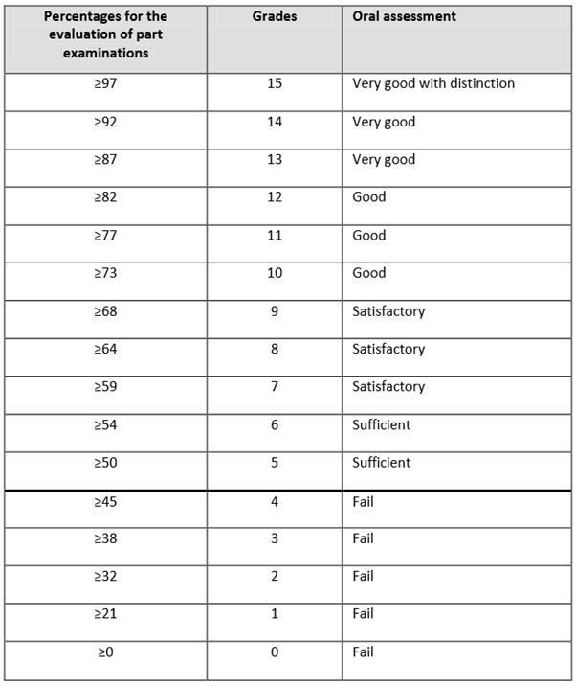
GRADING SYSTEM

Slide 14
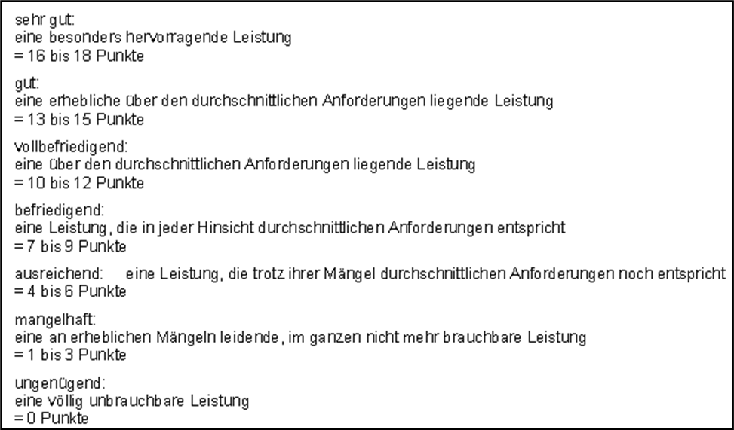
GRADING SYSTEMS - LAW

Slide 15
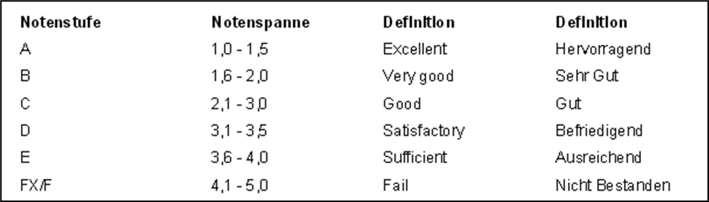
GRADING SYSTEMS - MEDICINE

Slide 16
CREATING YOUR TIME-TABLE
Please refer to your study plan (Studienverlaufsplan – SVP) and module descriptions for the modules/courses you need to take.
In the electronic course catalog (eVV) you will find an overview of the courses currently offered and the corresponding direct link to Stud.IP.
For some courses you have to register additionally via FlexNow. Please always observe the registration and de-registration deadlines by your faculty.

Slide 17
ACADEMIC EXPECTATIONS
Self-Responsibility and Independence
The "Leistungsnachweis": Most courses rely on a single final exam or paper at the end of the semester. Continuous homework is rare.
Scientific Rigor: Plagiarism is taken extremely seriously.
Active Participation: In seminars, you aren't just a listener. You are expected to contribute to discussions and challenge ideas.
Self-Study (Selbststudium): For every hour spent in a lecture, expect to spend 2–3 hours in the library.

Slide 18
COMMUNICATION WITH PROFESSORS
Professional, Formal, and Direct
The Golden Rule of Titles:
Always use formal titles in emails.
Email Etiquette:
Use your university email address.
Be concise and get straight to the point (no long "hope you are well" intros).
Include your matriculation number and the specific course name.

Slide 19
COMMUNICATION WITH PROFESSORS
Office Hours (Sprechstunden): Check the faculty website to see if you need to book a slot via a sign-up sheet or online tool.
Feedback: Feedback is often direct. If you receive a critique, don't take it personally.

Slide 20
PRACTICAL INSIGHTS
The Paperwork "Paper Trail"
Germany is still very much a paper-based society. Keep every contract, insurance document, and university certificate. You will need original hard copies for almost every administrative appointment (Behördengänge).
Postal Mail: Important official news (from the bank, the city, or the university) will come via physical mail, not email. Check your mailbox daily!

Slide 21
PRACTICAL INSIGHTS
The Quiet Rule: Avoid loud housework (drilling, vacuuming) or loud music on Sundays; it is legally protected "quiet time."
Sunday is "Ruhetag" (Rest Day)
Almost all supermarkets, shops, and pharmacies are closed on Sundays.
Plan Ahead: Do your grocery shopping by Saturday evening. Only shops in major train stations or gas stations remain open.

Slide 22
PRACTICAL INSIGHTS
Cash is (Still) King
"Nur Barzahlung": You will frequently see signs saying "Cash only" in bakeries, small cafes, and traditional restaurants.
The "Girocard": Many places that take cards only accept the local German Girocard (EC-Karte), not international Visa or Mastercards. Always carry at least €20 in cash.

Slide 23

Quick "Cultural Hacks"
Punctuality: 5 minutes early is on time. Late is unacceptable.
Pfand (Bottle Deposit): Never throw away plastic bottles or glass bottles.
(Most supermarkets have automatic machines that scan your bottles and give you a receipt. You can use this receipt to get cash at the checkout or reduce your shopping bill.)

Slide 24
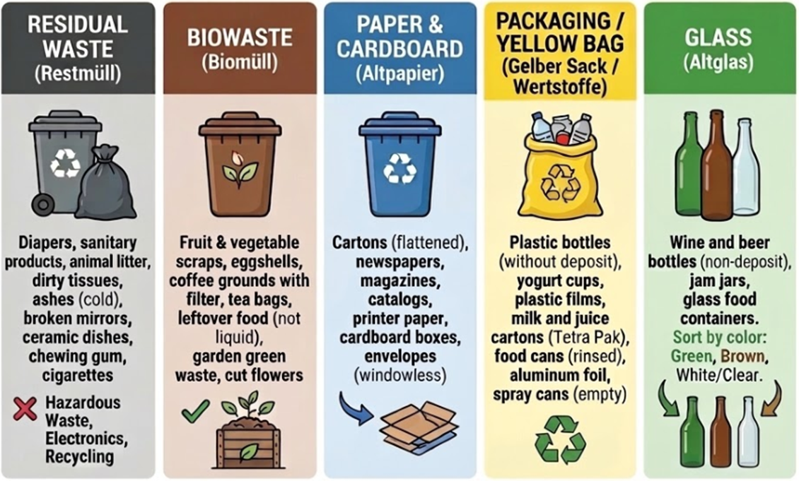
Quick "Cultural Hacks"
Waste Sorting: Germans are world champions at recycling. There are usually four different bins (Paper, Plastic/Metal, Bio, and Rest).

Slide 25
Quick "Cultural Hacks"
Where to Find Glass Recycling Containers: Altglascontainer in Gießen / Stadt Gießen
Note: The color of the organic waste bin may vary between brown and green depending on the city.

Slide 26
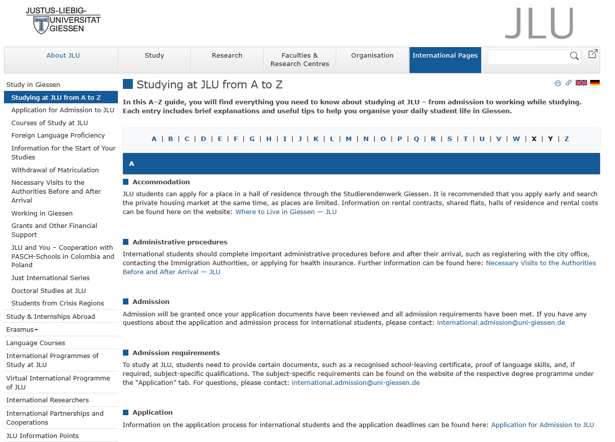
A-Z GUIDE
Notes:
https://www.uni-giessen.de/en/international-pages/study/a-z?set_language=en

Slide 27
Impressum
International Office
Akademisches Auslandsamt
Goethestrasse 58
35390 Giessen
international.students@uni-giessen.de
www.uni-giessen.de/internationales
THANK YOU FOR JOINING US TODAY!

